Slide 1
DeepFake Challenge
Simulated participation in Kaggle DeepFake Detection Challenge
W251 Deep Learning in the Cloud and at the Edge (Spring 2020) Final Project
Michael Zeng, Richard Ryu, Adam Sohn
Notes:
Adam starts

Slide 2
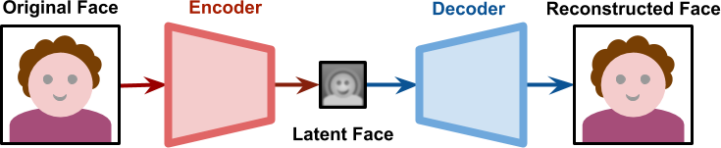
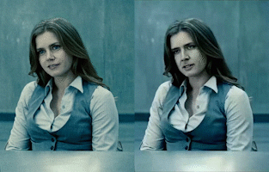
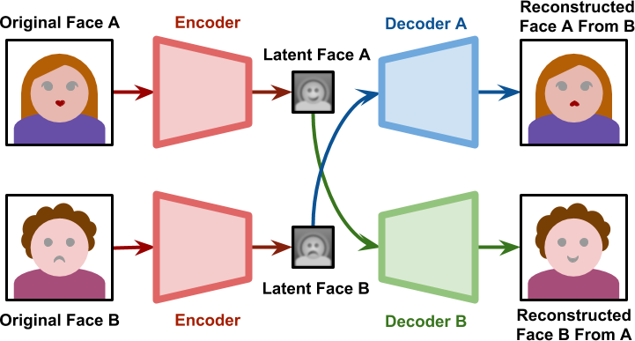
What is DeepFake?
GAN w/o fake
Deepfake generating GAN
Amy Adams / Nicholas Cage
Notes:
Sources:
https://en.wikipedia.org/w/index.php?curid=61555724
https://www.alanzucconi.com/2018/03/14/understanding-the-technology-behind-deepfakes/
Who was really in the movie? Amy Adams or Nicholas Cage?
So what is a deepfake
When executing a Generative Adversarial Network w/o DeepFake logic, encoder distills out a Latent Face, which can be thought of as the key facial features of what makes Nicholas Cage himself. The decoder then applies those features to the base image, which should be make a facsimile of original.
If you switch the latent faces, however, between 2 images, then you get deepfake: an image with key facial features swapped out.

Slide 3
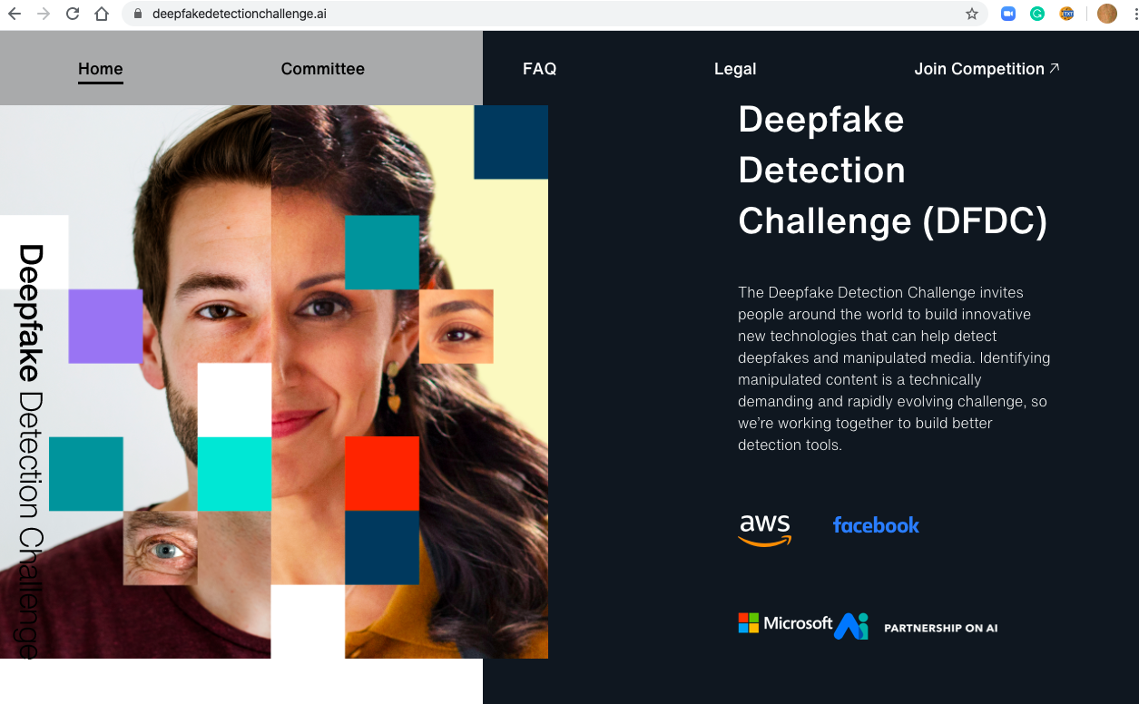
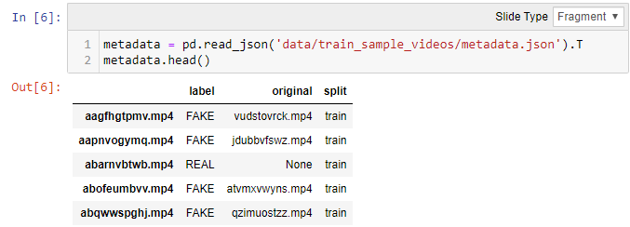
What is DeepFake Detection Challenge?
Training Set - (50) 10 Gb files in a Kaggle GCS bucket
Public Validation Set - 400 videos/ids for tests/Kaggle submission
Notes:
Sources:
https://deepfakedetectionchallenge.ai/
Although entertaining, there are dire implications for Fake News.
Big tech names (Amazon, Facebook, Microsoft) put up $1M in prizes for a Kaggle Challenge to improve detection technology.
Congratulations to Darragh for placing 5th!
Kaggle provided half a TB of training videos and a validation set for testing.
The data comes with metadata descriptors including a categorical label Real/Fake and a link to original video.

Slide 4
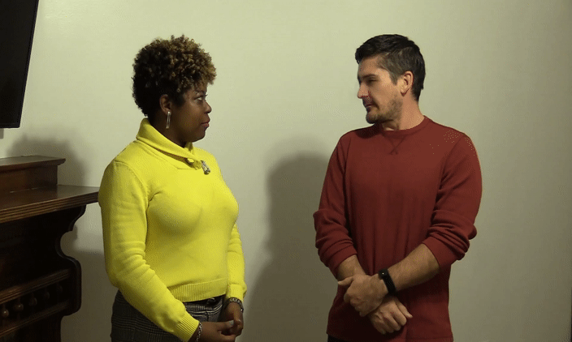
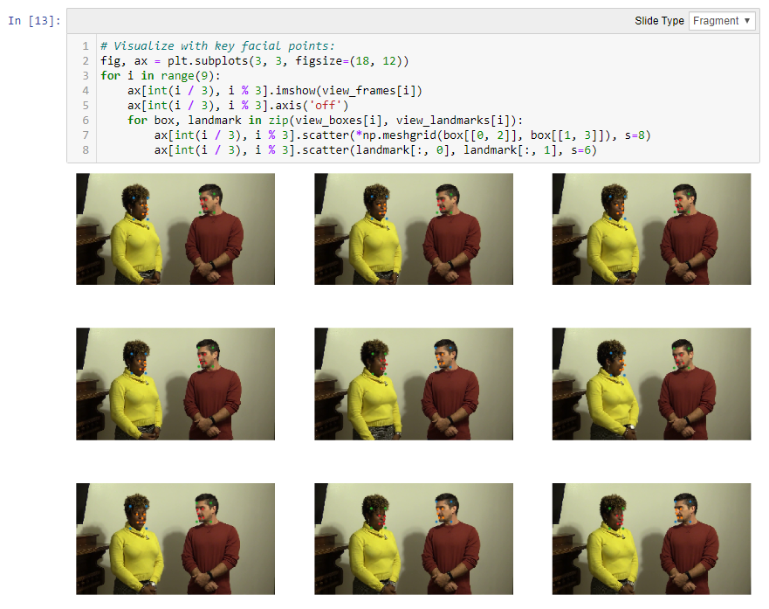
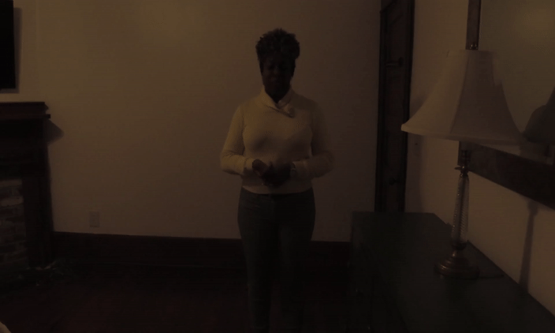
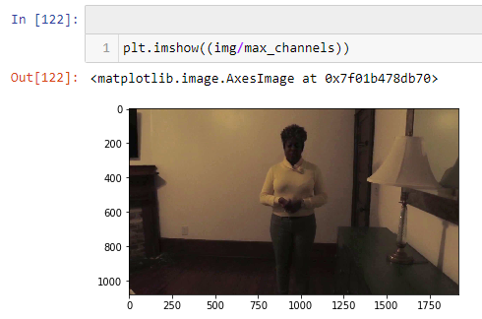
EDA
Example Fake
Facial Keypoint Detection
Too dark to make out face
Solution: Augmentation to brighten
Strategy: By image - Normalize on same-image Max([R,G,B]) or use minimum color value threshold
Notes:
EDA was a fun part of the project.
It was known that the Deepfake was performed in face only. See if you can notice for yourself the imperfection in the upper left. I think you see it only if you know to look.
We explored facial keypoint detection in addition to faces and that worked out well. This indicated that the deep learning models will be able to note differences in features.
For the bottom left image, you can see that the image is too darkly lit to make out a face. The solution was a custom augmentation to brighten. Either normalize each color channel or use minimum color intensity threshold.

Slide 5
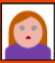
Our Approach to Deepake Detection
GAN w/o fake
Deepfake generating GAN
LSTM Discriminator
Still images from video
Encoder
Latent Faces
Decoder
REAL
FAKE
Notes:
Sources:
https://www.alanzucconi.com/2018/03/14/understanding-the-technology-behind-deepfakes/

Slide 6
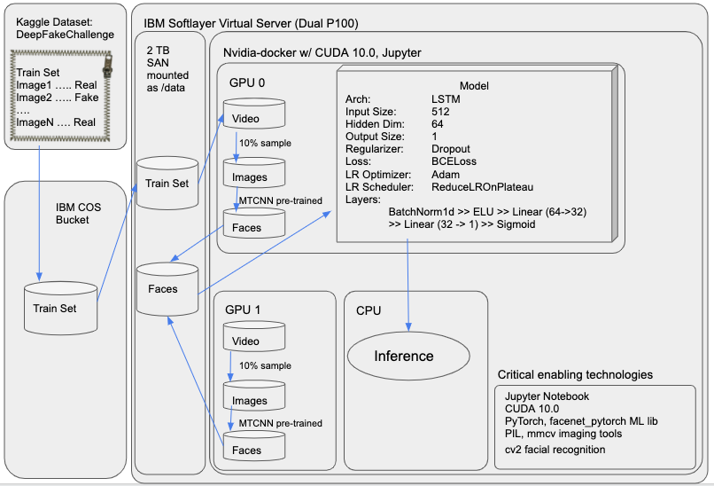
Pipeline
Notes:
Michael starts

Slide 7
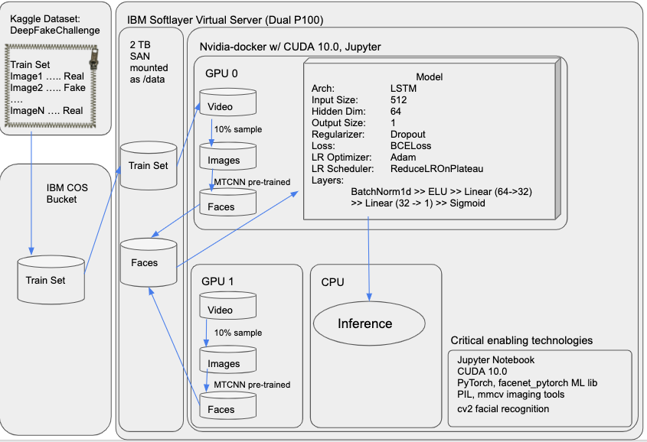
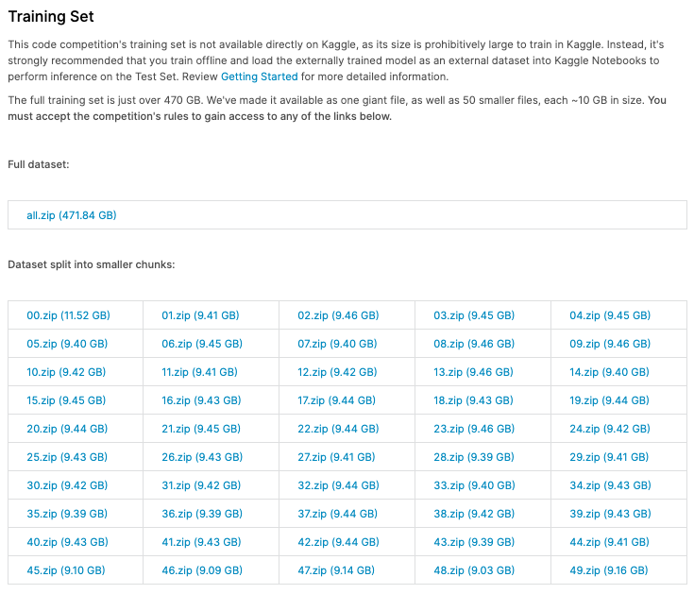
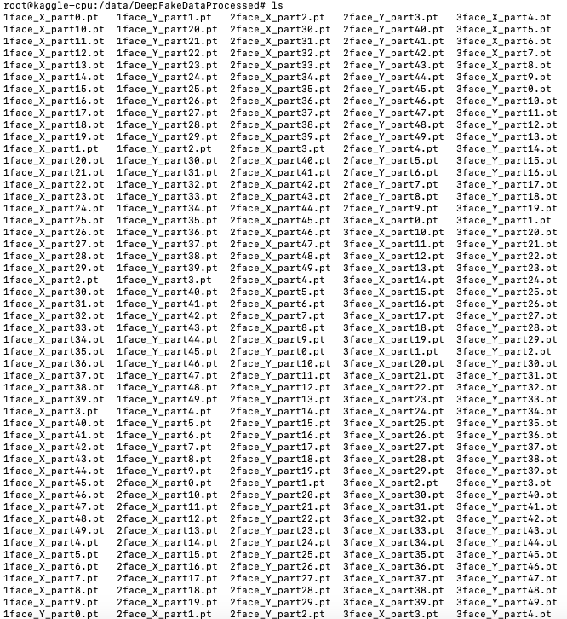
Data
Notes:
Sources:
https://deepfakedetectionchallenge.ai/
https://www.kaggle.com/c/deepfake-detection-challenge/data

Slide 8
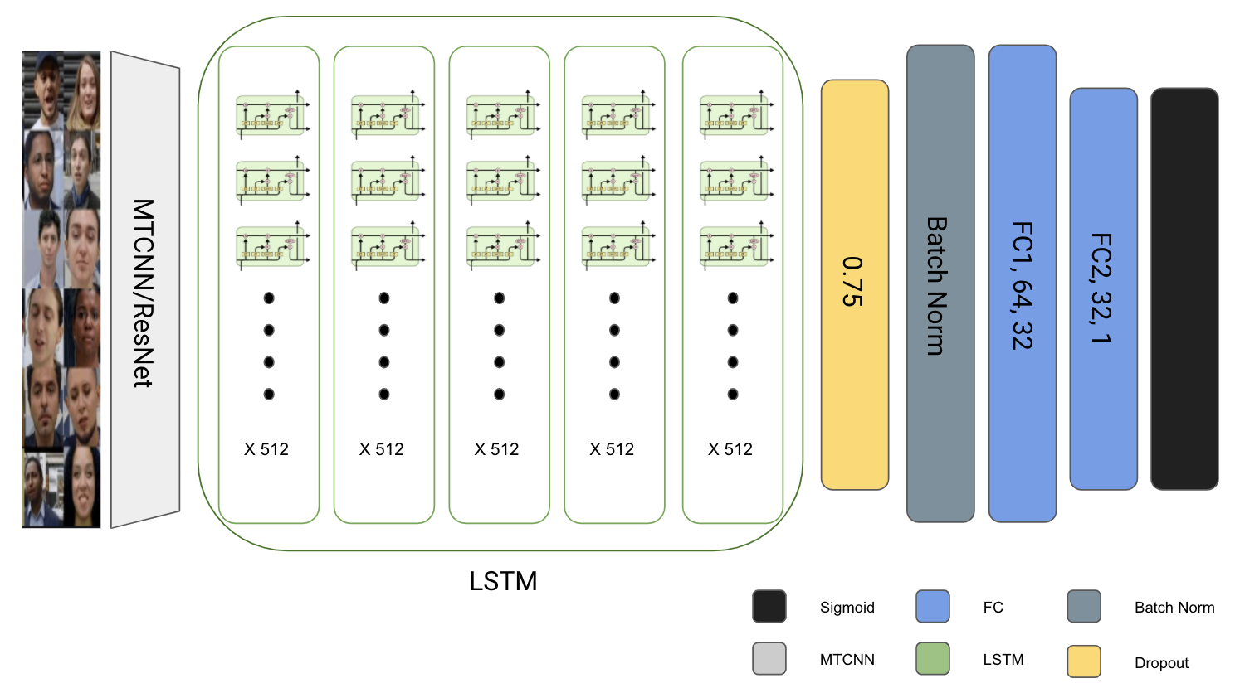
Model Architecture

Slide 9
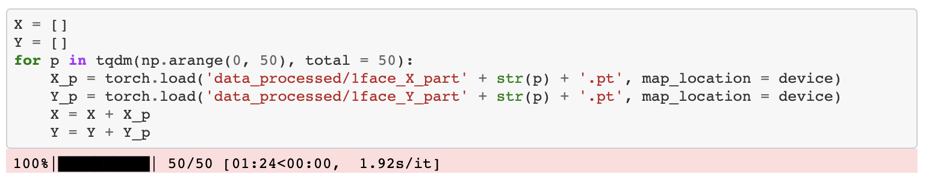
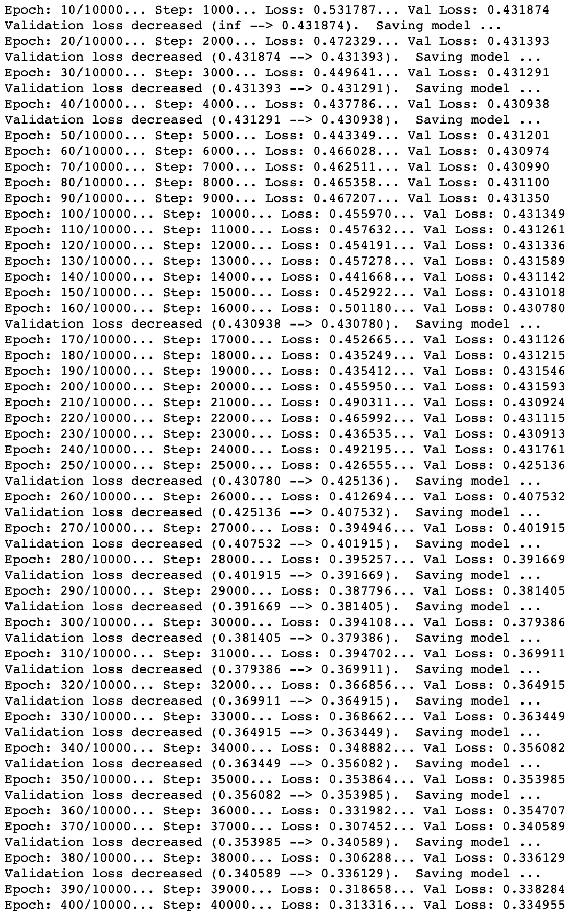
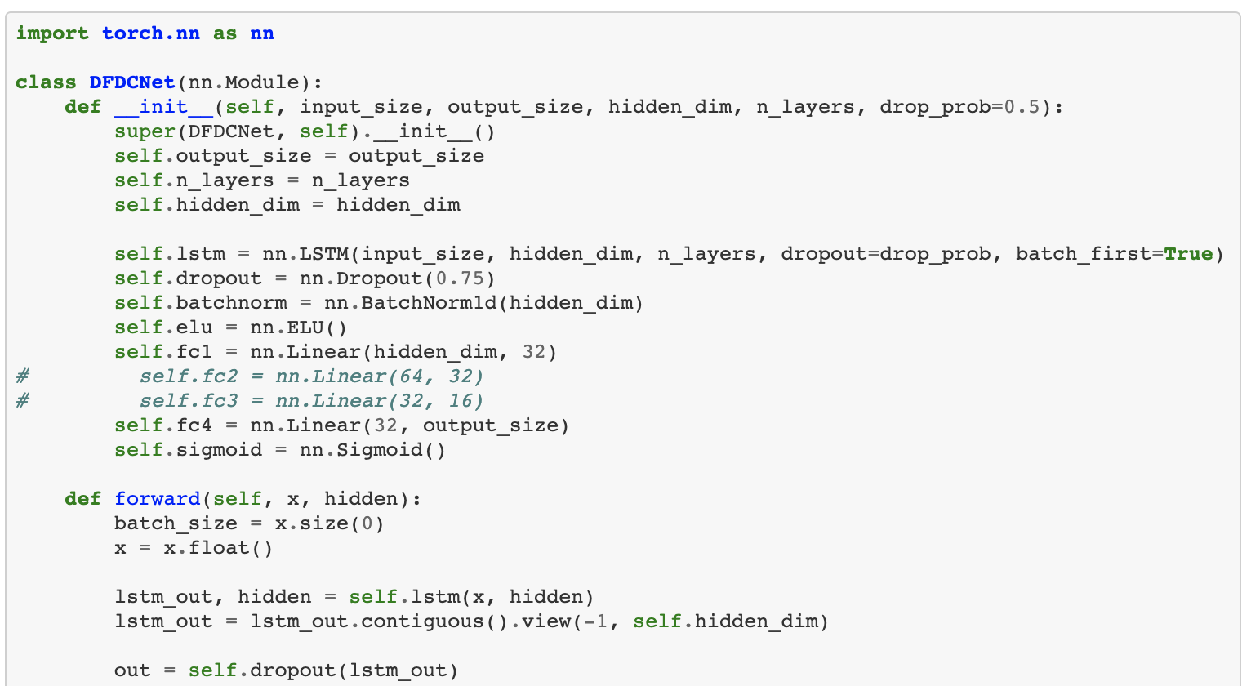
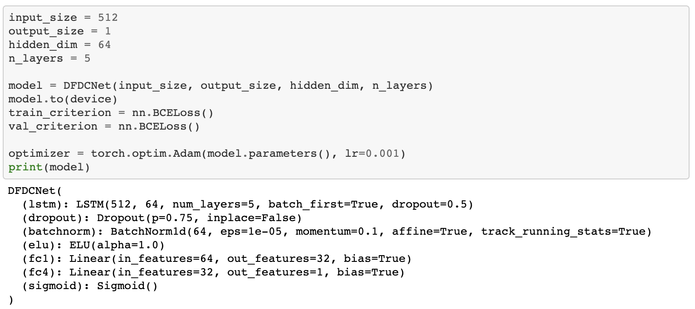
Model Training/Validation

Slide 10
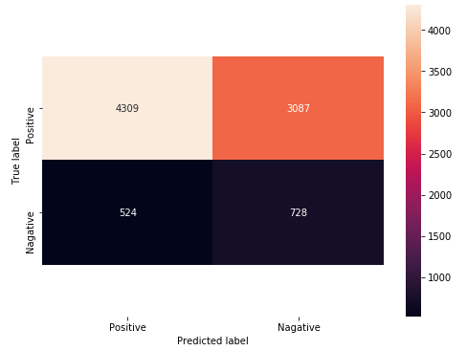
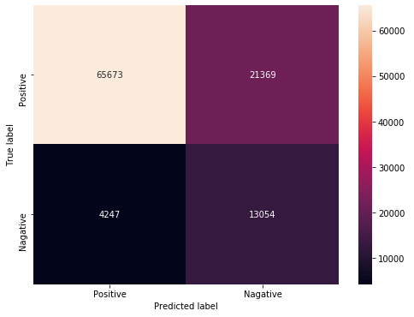
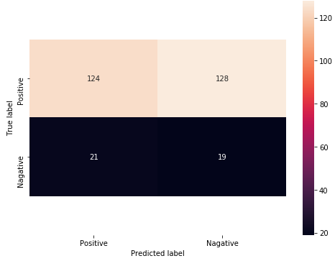
Results
Reference:
Accuracy = TP + TN
TP + TN + FP + FN
Precision = TP
TP + FP
Recall = TP
TP + FN
# of faces | Test Data Points | Log Loss | Accuracy | Precision | Recall
1 | ~100k | 0.32 | 0.75 | 0.75 | 0.94
2 | ~8.6k | 0.60 | 0.58 | 0.58 | 0.89
3 | 292 | 0.62 | 0.49 | 0.59 | 0.86
Overall 0.34
One Face
Two Face
Three Face
Notes:
Richard starts
Winner 0.19
Darragh 0.22
Ours 0.32
Little Work: 0.60

Slide 11
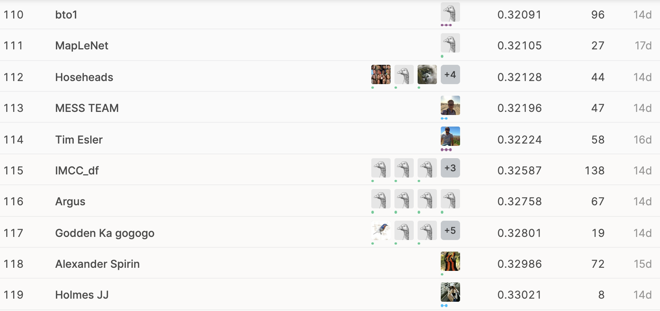
Kaggle Results
# of faces | Test Data Points | Log Loss | Accuracy | Precision | Recall
1 | ~100k | 0.32 | 0.75 | 0.75 | 0.94
2 | ~8.6k | 0.60 | 0.58 | 0.58 | 0.89
3 | 292 | 0.62 | 0.49 | 0.59 | 0.86
Overall 0.34
Notes:
Richard starts
Winner 0.19
Darragh 0.22
Ours 0.32
Little Work: 0.60

Slide 12
Future Improvement Paths
References
Sample additional frames (~300 frames available per video)
Attempt other model types & hyperparameter sets
Cultivating better training data set:
Augmentations to increase image count
Make similar distribution of fake vs. real training videos
Improve facial recognition
Filter out incorrect faces (ie. printed on shirt)
Torso + head logic
Tackle out-of-memory issues performing inference on Kaggle submission.
Reduce batch size
Increase cache size
https://github.com/zengm71/DeepFakeChallenge
https://www.kaggle.com/c/deepfake-detection-challenge/overview

